Slide 1
Power BI Assignment 1
By: Ankit Narang

Slide 2
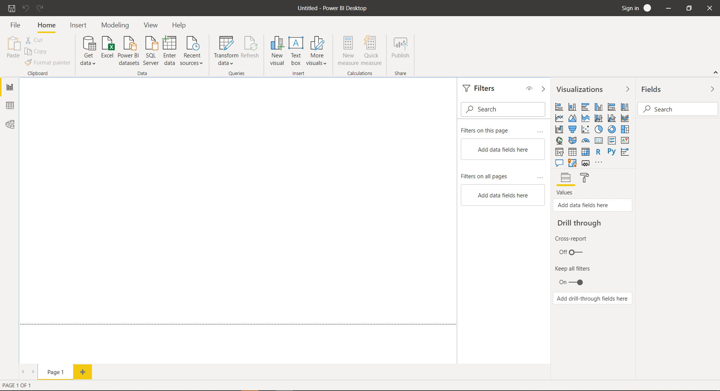
Power BI Report View

Slide 3
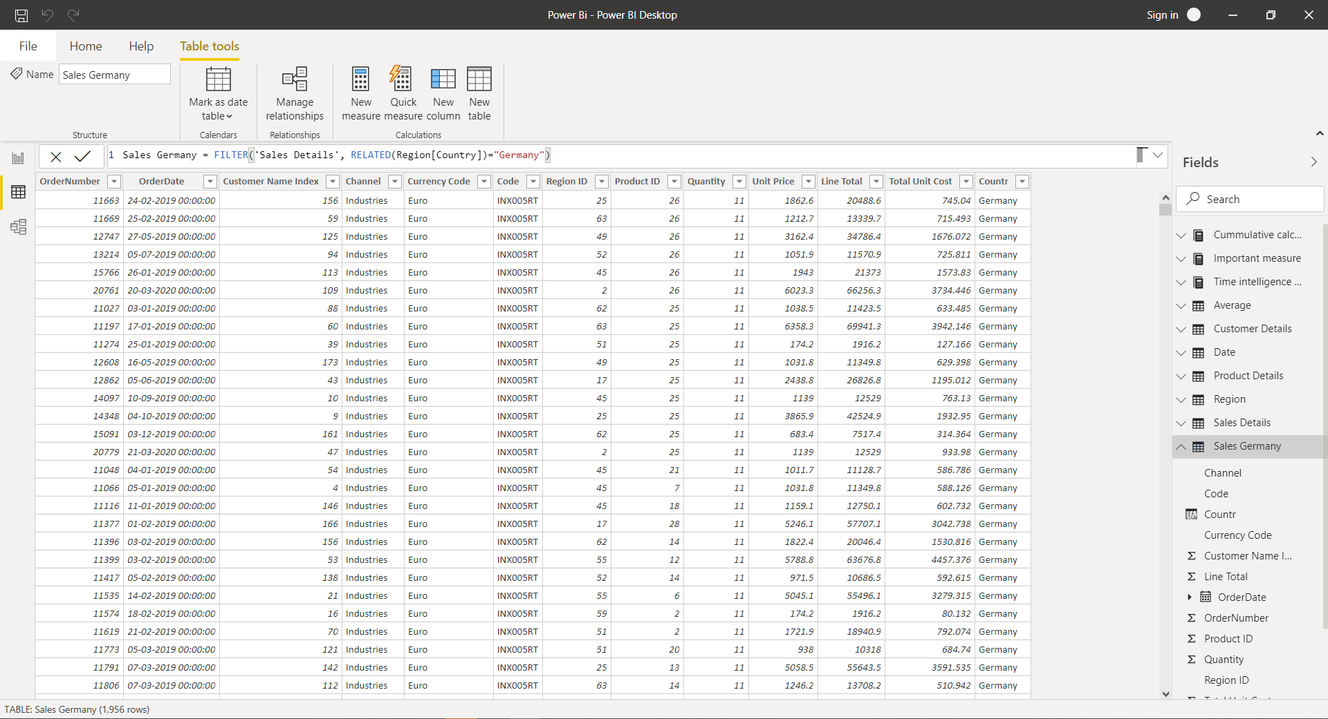
Power BI Data View

Slide 4
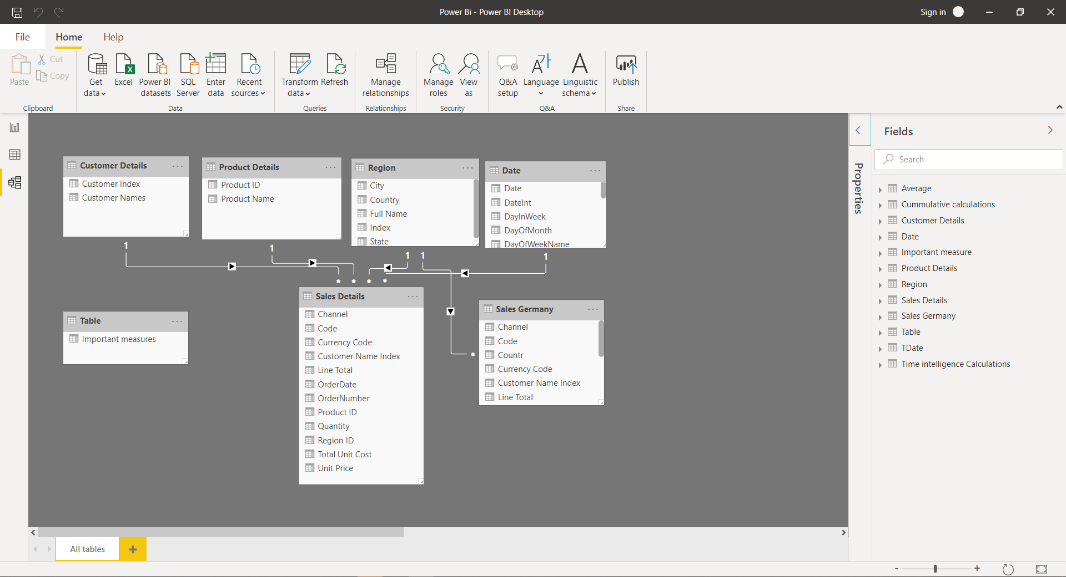
Power BI Model View

Slide 5
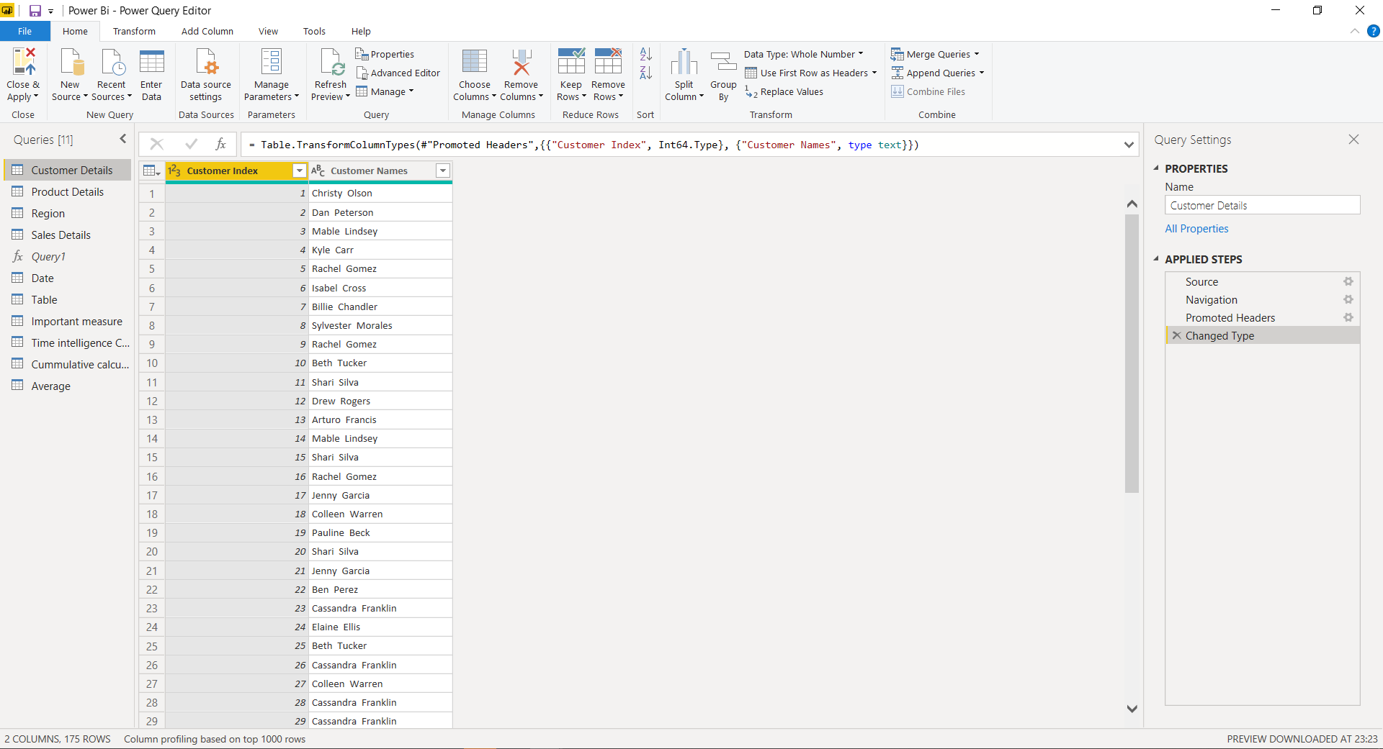
Power Query Editor

Slide 6
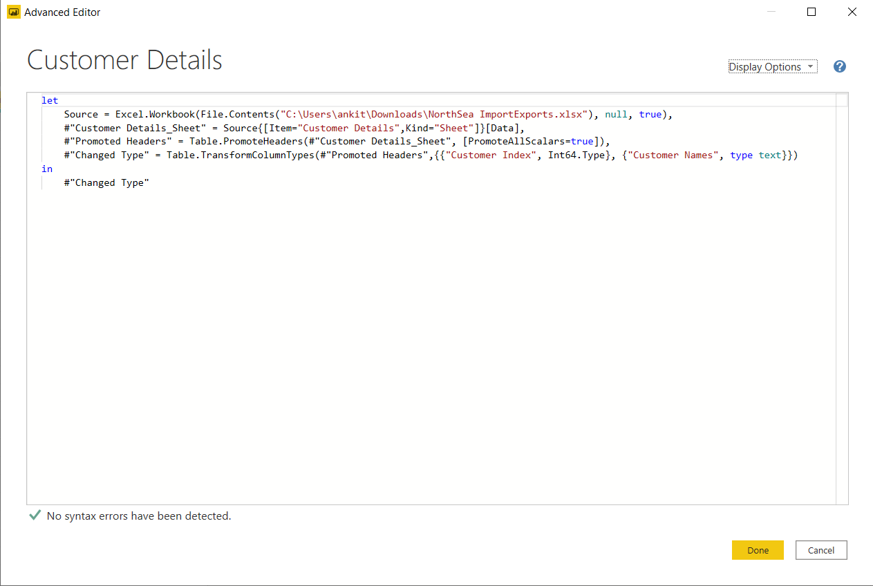
Advanced Editor

Slide 7
Power BI Pricing
Power BI comes in three levels – Desktop, Pro, and Premium. The Desktop level is free for individual users, while the Pro plan costs ₹660 per user per month. The Premium plan starts at ₹ 330,190 a month per dedicated cloud compute and storage resource.

Slide 8
